Slide 1


JAVA (Skill Based Lab)
MODULE 5: Exception Handling and Threads
Prof Indu Anoop

Slide 2
Exception Handling: Exception-Handling Fundamentals, Exception Types, Exception class Hierarchy, Using try and catch, Multiple catch Clauses, Nested try Statements, throw, throws, finally , Java’s Built-in Exceptions, Creating Your Own Exception Subclasses

Slide 3
Exception: Exception is any unwanted or unexpected event which occurs during the execution of a program, that disrupts the normal flow of the program. When the programmer does something (use of try –catch block) to handle the exception then it’s called exception handling
Types of Exception:Checked and Unchecked
Checked exception (Compile Time Exception)
Unchecked exception (Runtime Exception)
User Defined Exception or custom exception is creating your own exception class and throw that exception using ‘throw’ keyword.
This can be done by extending the class Exception which makes it a checked Exception Type or by extending the RuntimeException Class which makes it an unchecked Exception

Slide 4
Concepts: Try block
try block: The try block contains set of statements where an exception can occur. A try block is always followed by a catch block, which handles the exception that occurs in associated try block. A try block must be followed by catch blocks or finally block or both.
Syntax of try block
try { //statements that may cause an exception
}
While writing a program, if you think that certain statements in a program can throw a exception, enclosed them in try block and handle that exception

Slide 5
Concepts: Catch block
A catch block is where you handle the exceptions, this block must follow the try block. A single try block can have several catch blocks associated with it. You can catch different exceptions in different catch blocks. When an exception occurs in try block, the corresponding catch block that handles that particular exception executes. For example if an arithmetic exception occurs in try block then the statements enclosed in catch block for arithmetic exception executes.
Syntax of try catch in java
try { //statements that may cause an exception
}
catch (exception(type) e(object)) {
//error handling code
}
Example: If an exception occurs in try block then the control of execution is passed to the corresponding catch block. A single try block can have multiple catch blocks associated with it

Slide 6
Concepts: finally block
Java finally block is a block that is used to execute important code such as closing connection, stream etc. Java finally block is always executed whether exception is handled or not. Java finally block follows try or catch block. Finally block in java can be used to put "cleanup" code such as closing a file, closing connection etc. .
Let's see the java finally example where exception occurs and not handled.
class TestFinallyBlock{
public static void main(String args[]){
try{ int data=25/0;
System.out.println(data);
}
catch(NullPointerException e){
System.out.println(e);
}
finally{
System.out.println("finally block is always executed");
}
System.out.println("rest of the code..."); }
}
Output: finally block is always executed Exception in thread main java.lang.ArithmeticException:/ by zero

Slide 7
Program (Exp 9:User Defined Exception handling: PasswordException)
Write java program where user will enter loginid and password as input. The password should be 8 digit containing one digit and one special symbol. If user enter valid password satisfying above criteria then show “Login Successful Message”. If user enter invalid Password then create InvalidPasswordException stating Please enter valid password of length 8 containing one digit and one Special Symbol.

Slide 8
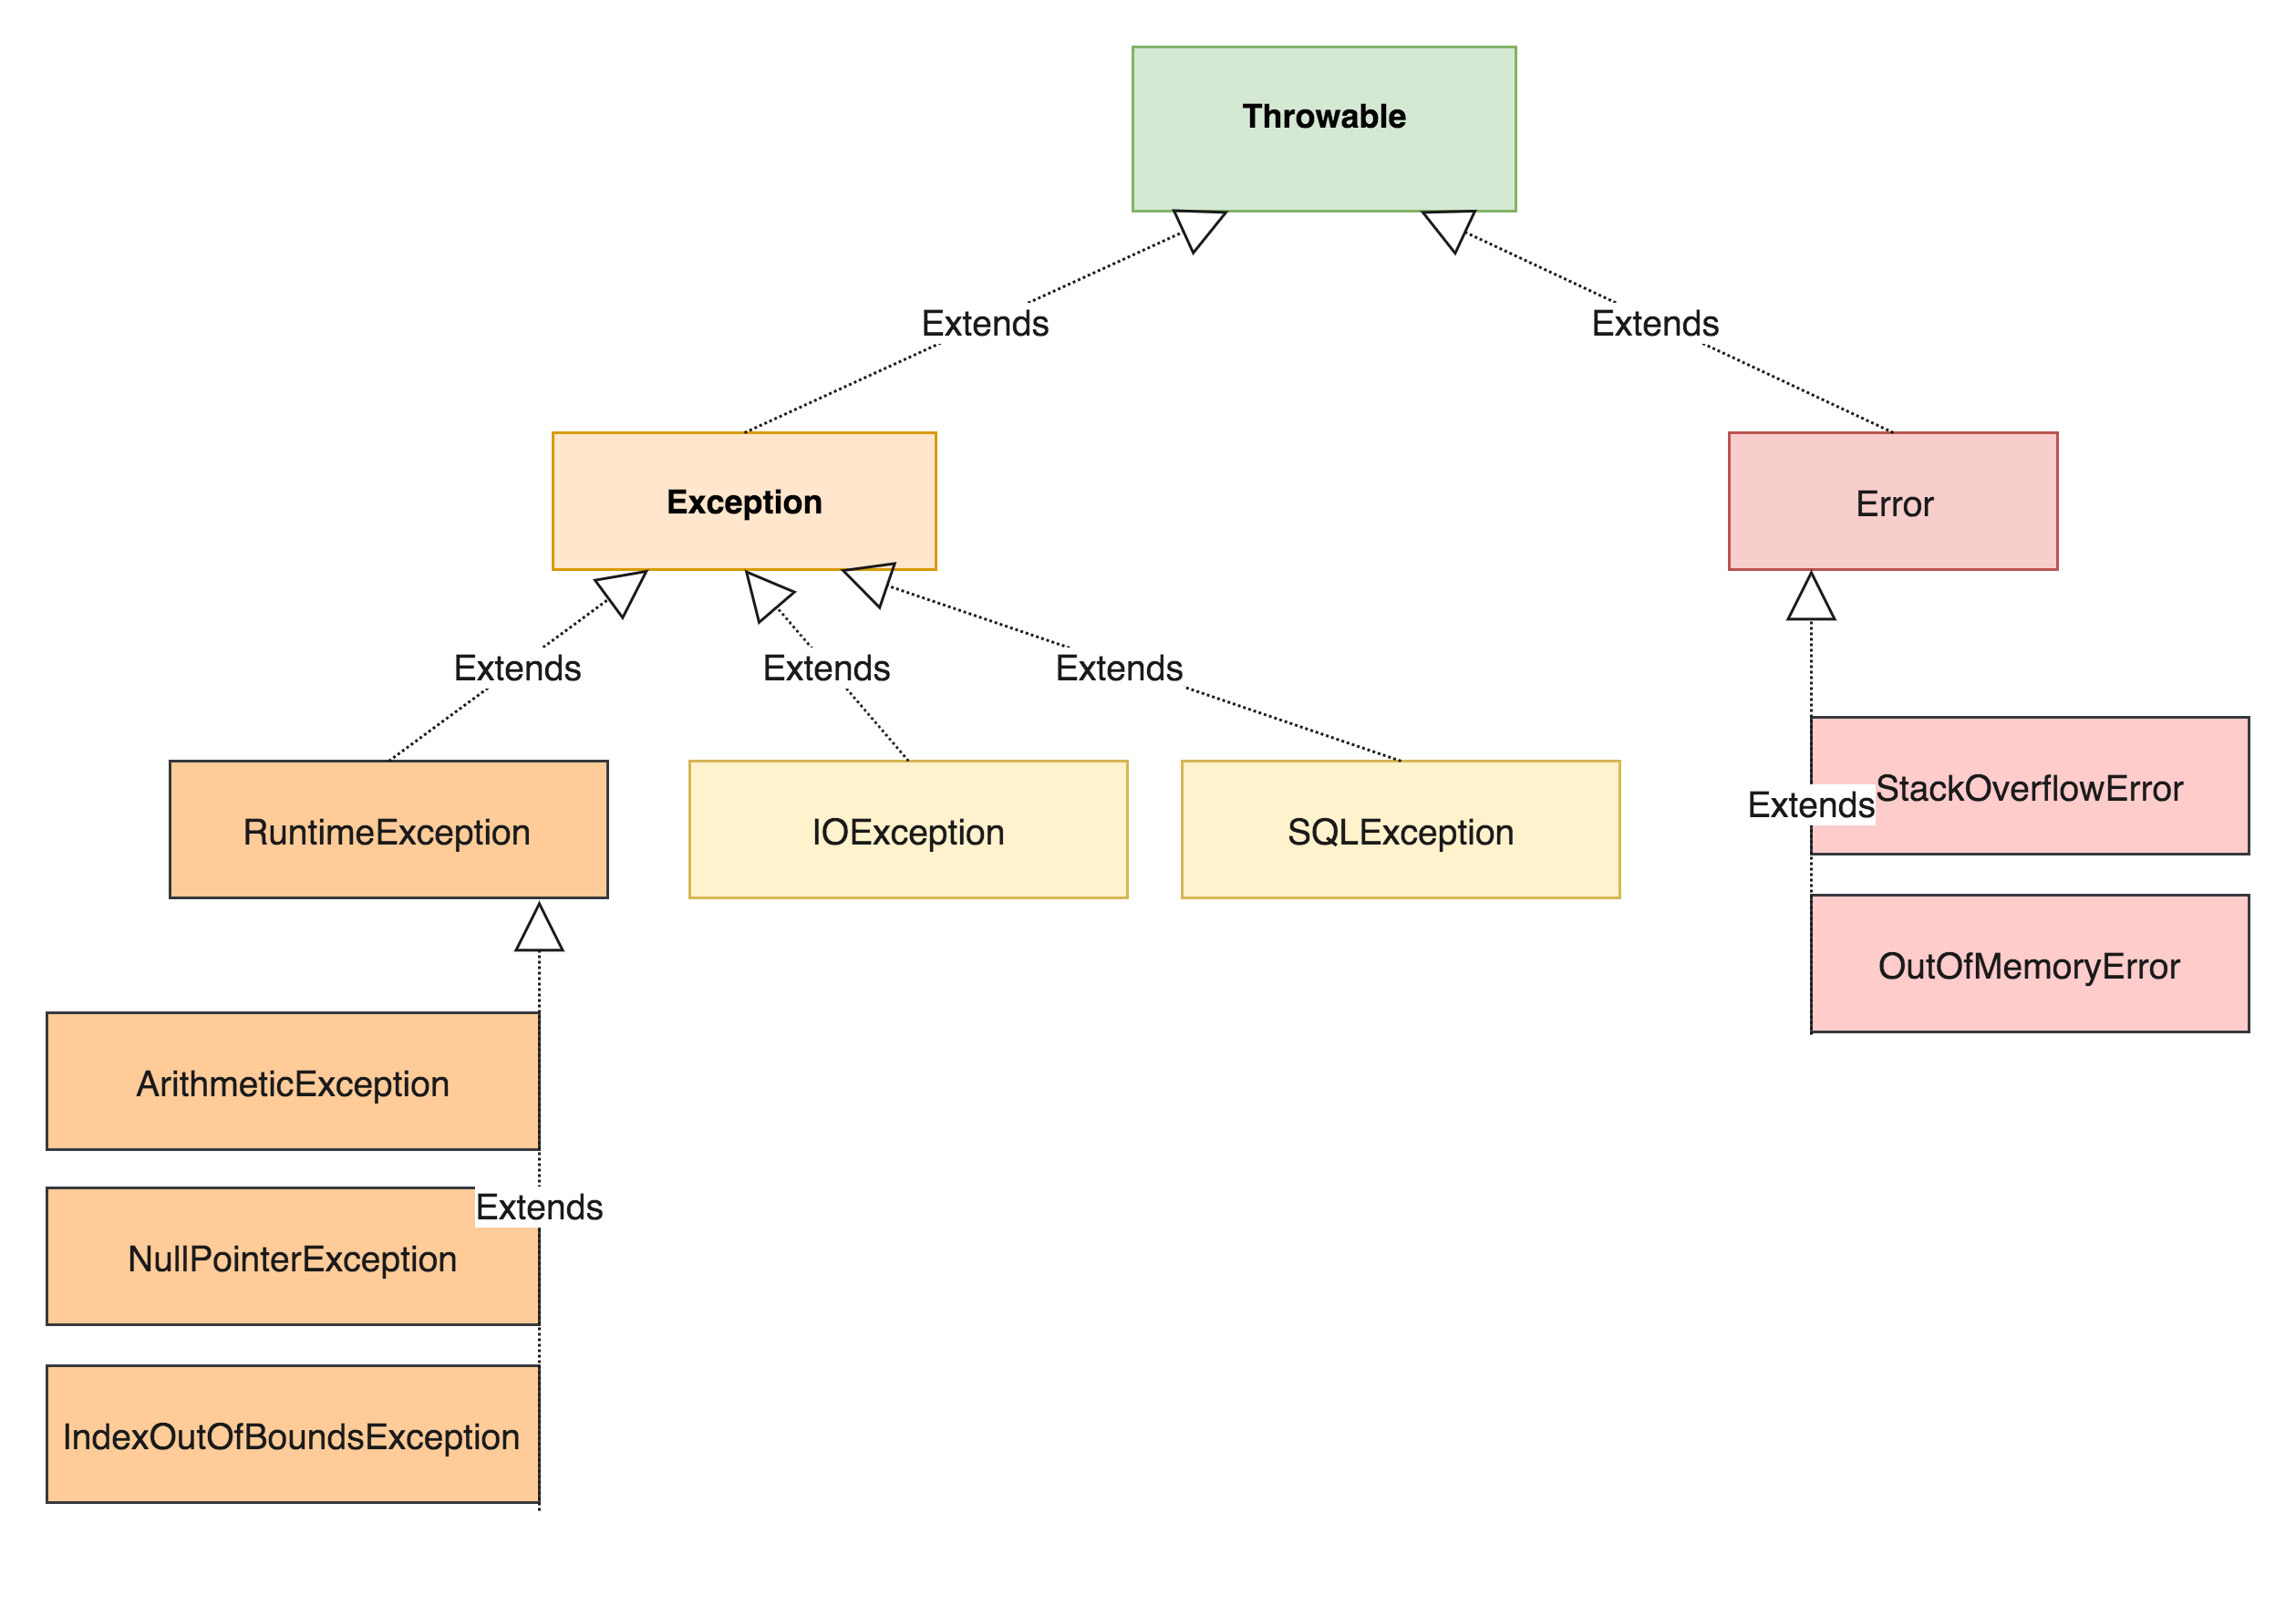

Slide 9
Multithreaded Programming: The Java Thread Model and Thread Life Cycle, Thread Priorities, Creating a Thread, Implementing Runnable, Extending Thread, Creating Multiple Threads, Synchronization: Using Synchronized Methods, The synchronized Statement

Slide 10
What is thread?
A thread is a light weight process.
A thread is a subpart of a process that can run individually.
In java, a thread goes through different states throughout its execution. These stages are called thread life cycle
The thread base is an instantiation of a class which either
implements Runnable
extends Thread
Thread class: Thread class provide constructors and methods to create and perform operations on a thread. Thread class extends Object class and implements Runnable interface.
Runnable interface: The Runnable interface should be implemented by any class whose instances are intended to be executed by a thread. Runnable interface have only one method named run()

Slide 11
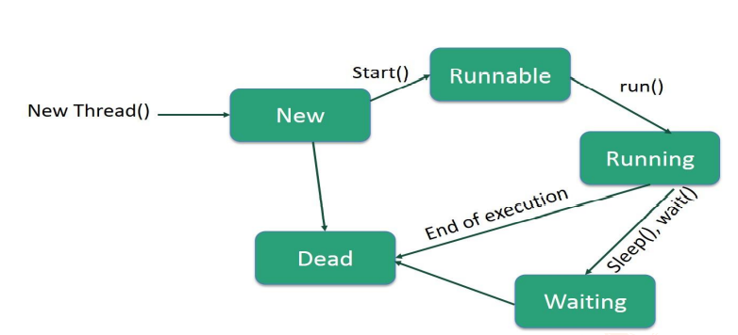
Thread Life Cycle

Slide 12
New Born State
Ready to run mode (Runnable Mode)
The thread enters the new born state as soon as it is created. The thread is created using the new operator.
From the new born state the thread can go to ready to run mode or dead state.
If start( ) method is called then the thread goes to ready to run mode. If the stop( ) method is called then the thread goes to dead state.
Running State:--
If the thread is ready for execution but waiting for the CPU the thread is said to be in ready to run mode.
All the events that are waiting for the processor are queued up in the ready to run mode and are served in FIFO manner or priority scheduling.
From this state the thread can go to running state if the processor is available using the scheduled( ) method.
From the running mode the thread can again join the queue of runnable threads.
The process of allotting time for the threads is called time slicing.
If the thread is in execution then it is said to be in running state.
The thread can finish its work and end normally.
The thread can also be forced to give up the control when one of the following conditions arise
A thread can be suspended by suspend( ) method. A suspended thread can be revived by using the resume() method.
2. A thread can be made to sleep for a particular time by using the sleep(milliseconds) method.
The sleeping method re-enters runnable state when the time elapses.
3. A thread can be made to wait until a particular event occur using the wait() method, which can
be run again using the notify( ) method.
Dead State
The running thread ends its life when it has completed executing the run() method which is called natural dead.
The thread can also be killed at any stage by using the stop( ) method.

Slide 13
Dead State
The running thread ends its life when it has completed executing the run() method which is called natural dead.
The thread can also be killed at any stage by using the stop( ) method.

Slide 14
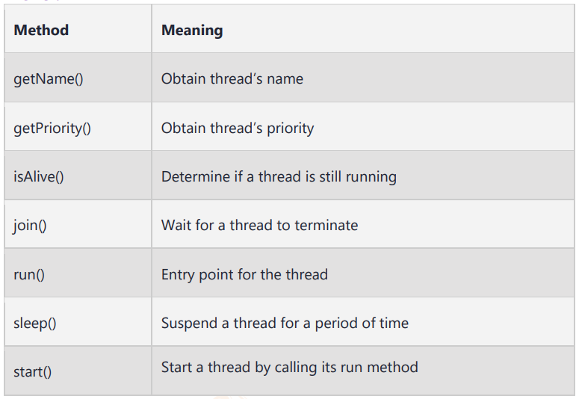
Thread Class Methods

Slide 15
1) Java Thread Example by extending Thread class
2) Java Thread Example by implementing Runnable interface
class Multi3 implements Runnable {
public void run() {
System.out.println("thread is running...");
}
public static void main(String args[]) {
Multi3 m1=new Multi3();
Thread t1 =new Thread(m1);
t1.start();
}
}
class Multi extends Thread {
public void run() {
System.out.println("thread is running...");
}
public static void main(String args[]) {
Multi t1=new Multi();
t1.start();
}
}
Output: thread is running..
Output: thread is running...

Slide 16
Synchronization
Java threads enforce asynchronous behavior; as a result, they must be synchronized explicitly, especially when dealing with shared resources. For example, when we have an idea that the executing threads may compete for a single resource, we must enclose them in a synchronization block to ensure that a conflicting situation do not arise.

Slide 17
Program (Exp 14: WAP to demonstrate Multithreading )
Assume that two brothers, Joe and John, share a common bank account. They both can, independently, read the balance, make a deposit, and withdraw some money. Implement java application demonstrate how the transaction in a bank can be carried out concurrently.

